Slide 1

Flinkit
By-Mayur Gd

Slide 2
INSTRUCTIONS
How to use this template?
Click on "File" and then "Make a Copy" of the template to use it.
Edit each of the slides and table to add your responses.
Come up with a catchy title for the project and do not simply write "Minor Project 3: Search Engine Optimisation Strategy for FlinkIt".
Use the primary colours and logo of the assigned brands on the Cover Page and wherever necessary in the project.
Feel free to use your creativity to make the most use of the given template.
The maximum Number of Slides that can be used is 20.
Once you are happy with your responses, click on "Share", download it into a PDF file and submit it on the MyCaptain WebApp.

Slide 3
OBJECTIVES
Problem statement
Approach
Website structure
Topics ideas
Keyword research
On page elements
Competitive Analysis
Blog

Slide 4
PROBLEM STATEMENT
In today's fast-paced world, people often struggle to find the time to shop for daily essentials like groceries, toiletries, and other household items. Traditional brick-and-mortar stores require customers to dedicate time to visit the store, stand in long lines, and carry heavy items back home. This process is time-consuming and inconvenient, especially for those with busy schedules, elderly individuals, or people with mobility challenges
The challenge for Flinkit is to provide a seamless online ordering platform where customers can easily order daily essentials and have them delivered to their doorsteps in a timely and cost-effective manner. The goal is to create an efficient, user-friendly solution that ensures product availability, prompt delivery, and customer satisfaction while reducing the time and effort customers would typically spend on shopping for their everyday needs

Slide 5
APPROACH
A comprehensive Search Engine Optimization (SEO) strategy for Flinkit can help the platform improve its organic visibility, drive more traffic, and increase conversions. Here's an approach to SEO tailored to Flinkit's business model, focusing on both technical and content aspects
1. Keyword Research & Optimization
Target Audience Insights
Long-Tail Keywords
Voice Search Optimization
Local SEO
2.On-Page SEO Optimization
Product Page Optimization
Category & Landing Pages

Slide 6
Meta Tags
Internal Linking
3. Content Strategy & Blogging
Content Pillars
Blog Posts
User-Generated Content (UGC)
FAQ Section
4. Technical SEO
Site Speed Optimization
Mobile Optimization
Structured Data
Structured Data

Slide 7
Flinkit
Food
Drinks
Baby Care
Pet Care
Personal Care
Dairy Products
Tea
Diapers
Food
Body Care
Instant Food
Coffee
Feeding needs
Grooming Accessories
Bath and Beauty
Vegetables Fruits
Health Drinks
Bathing needs
Toys
Snacks
Cold Drinks
Hair and Skin Prouducts
Health Supplements

Slide 8
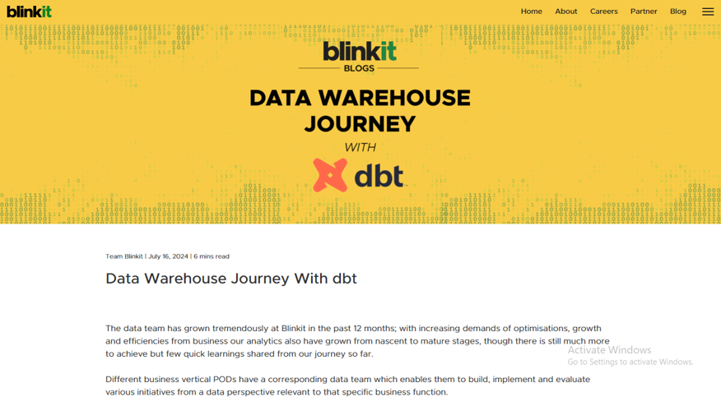
Blog Page

Slide 9
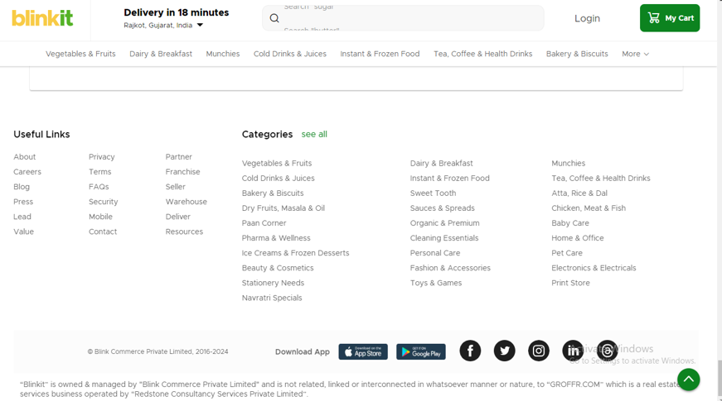
Categories page

Slide 10
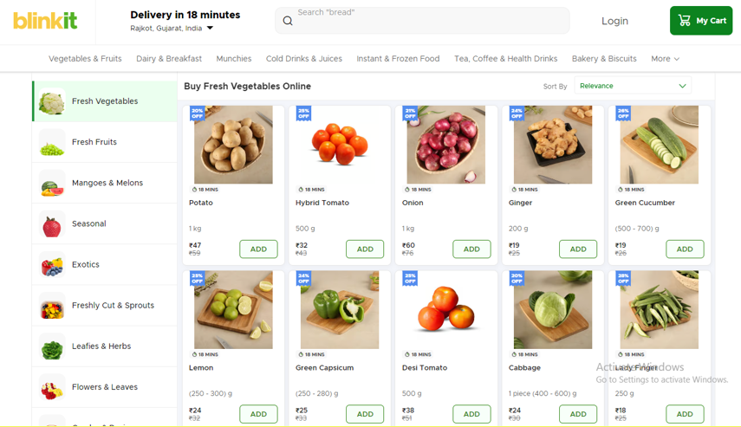
Sub Categories page

Slide 11
Content structure
Flinkit is a fast-commerce platform that focuses on delivering groceries and essentials to consumers in a quick and efficient manner. The content structure of Flinkit can be broken down into several key components, which are designed to provide a smooth user experience for browsing and ordering products. Here's a breakdown of its typical content structure:
1. Homepage
2. Product Pages
3. Shopping Cart
4. Checkout Flow
5. Account/Profile Page

Slide 12
Competitive Analysis
In the fast-commerce and online grocery delivery sector, Flinkit competes with several well-established and emerging brands. Major competitors include:
BigBasket
Amazon Pantry
JioMart
Dunzo
Zepto
Flipkart Supermart

Slide 13
Keyword Research
Here’s a breakdown of how to approach keyword research for Flinkit, including primary, secondary, long-tail keywords, and focus on local SEO:
Keyword Categories for Flinkit
Primary Keywords (High-Volume, General)
Online grocery delivery
Grocery delivery near me
Buy groceries online
Quick grocery delivery
Online food delivery
Grocery store delivery
Same-day grocery delivery
Online grocery shopping India
Grocery delivery app

Slide 14
Secondary Keywords (Product-Specific, Related)
Fresh produce delivery
Dairy delivery
Snacks delivery
Organic groceries online
Fresh fruits delivery
Buy vegetables online
Home essentials delivery
Healthy food delivery
Personal care products delivery
Frozen foods delivery

